Slide 1

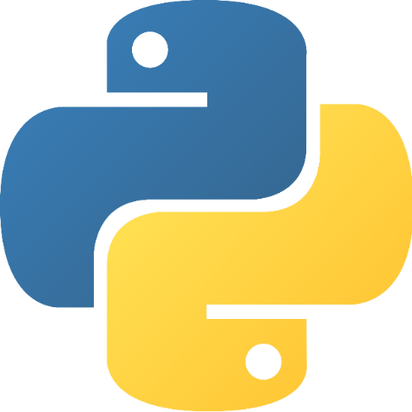

Python for beginners
Section 2: Control Flow
Saeede Anbaee Farimani
Phd, Member of Big Data & Blockchain Lab

Slide 2

today plan?
Loops
For
Range()
zip()
enumerate()
Reversed()
Sort()
While
Conditions
If statement
in , not in
Function declaration
Function call techniques
Lambda function
map and filter function
Simple text pre-processing

Slide 3
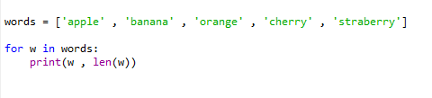



For statement
The for statement in Python differs a bit from what you may be used to in C or C++
Python’s for statement iterates over the iterable items, in the order that they appear in the sequence
Example 1
Output
Example 2
Output
For statement

Slide 4








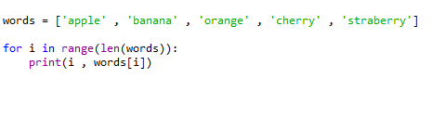

For statement
Range(start, end, step) : return a sequence of numbers between start to end with step.
Example 1
Example 2
Example 3
Example 4
Example 5
slice indexing in python

Slide 5
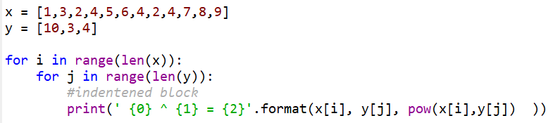
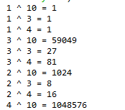
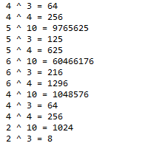
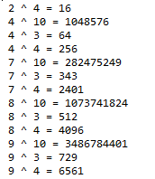
For statement
Python relies on indentation, using whitespace, to define scope in the code.
Do not forget ‘:’ at the end of loop or condition statements.
Example : pow (a , b)
slice indexing in python

Slide 6




For statement
Reversed ( iter ) : return iterable object in reversed order.
sorted( iter ) : sort iterable object.
Example 1
Example 2
slice indexing in python

Slide 7





For statement
For in one line !!
Example 1
enumerate( itrableObj , start ): return enumerate starting from start as tuple
Example 1
Example 2
slice indexing in python

Slide 8




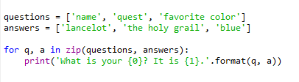
For statement
Zip( iter1, iter2 ) : return zip format of iter1 and iter2 as tuple.
Example 1
Example 2
slice indexing in python

Slide 9


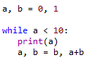

while statement
While: With the while loop, we can execute a set of statements as long as a condition is true.
Example 1
Fibonacci series:
slice indexing in python

Slide 10

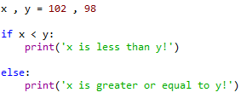
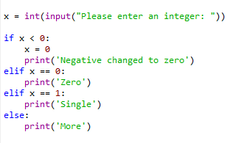

Condition statement
While: With the while loop, we can execute a set of statements as long as a condition is true.
Example 1
Example 2
Example 3
slice indexing in python

Slide 11


Condition statement
Operator in , not in with condition statement.
Example 1
Example 2
slice indexing in python

Slide 12

Condition statement
Operator in , not in with condition statement.
Example 1
Example 2
slice indexing in python

Slide 13
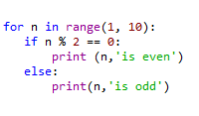
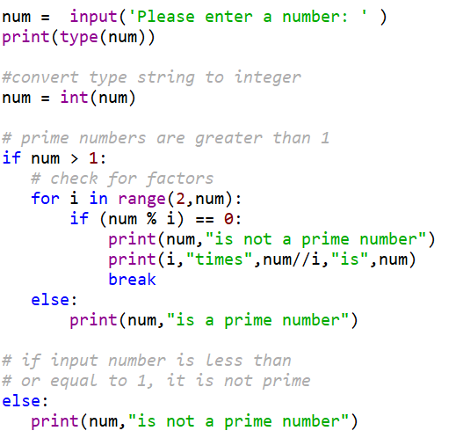



Control flow statements
Odd and even numbers :
Prime number : input()
slice indexing in python

Slide 14


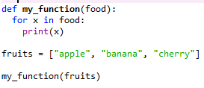


function declaration
A function is a block of code which only runs when it is called.
You can pass data, known as parameters, into a function.
A function can return data as a result.
Example 1: function declaration and calling
Example 2: function with input parameters
Example 3: function with list type as parameters
Functions

Slide 15



function declaration
A parameter is the variable listed inside the parentheses in the function definition.
An argument is the value that is sent to the function when it is called.
Example 1: function with two input parameters
Example 2: common Error in function calling
Functions

Slide 16

function declaration
We can call function with parameter’s names
Example : passing arguments with parameter’s names
Functions

Slide 17
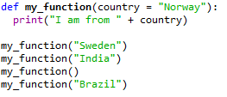

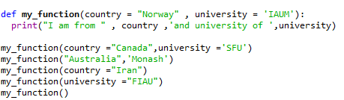

function declaration
After declaration of default values for parameters, we can pass arbitrary parameter number in function call
Examples 1
Examples 2
Functions

Slide 18

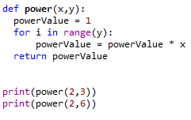


function declaration
to let a function return a value, use the reurn statement
Examples 1
Examples 2
Functions

Slide 19
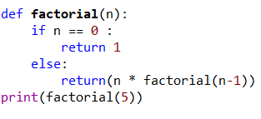
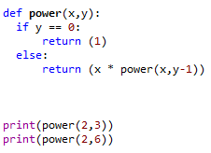

function declaration
Python also accepts function recursion, which means a defined function can call itself.
Examples 1
Examples 2
Functions

Slide 20




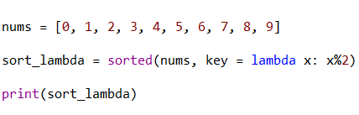

lambda function
A lambda function is a small anonymous function.
Lambda functions are inline functions and hence they are used whenever there is a need of repetitive function calls to reduce execution time
Many times lambda functions make code much more readable by avoiding the logical jumps caused by function calls.
Syntax : lambda arguments : expression
Examples 1
Examples 2
Examples 3
Functions

Slide 21

map function to a list
map function in Python takes in a function and a list as arguments.
The function is called with all the items in the list and a new list is returned which contains items returned by that function for each item.
Syntax: map( function , iterable)
Examples 1
Examples 2
Functions

Slide 22
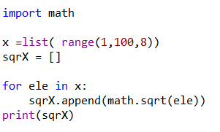
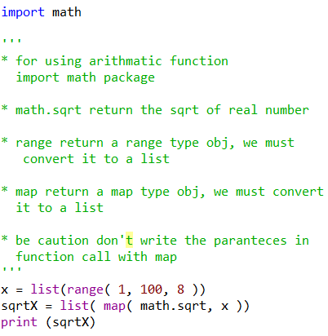
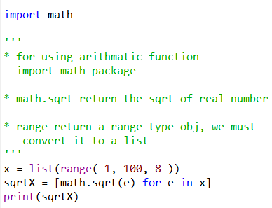
map function to a list
Program in three different ways
Examples 1: without map
Examples 1 : with map
Examples 1: without map
Functions

Slide 23

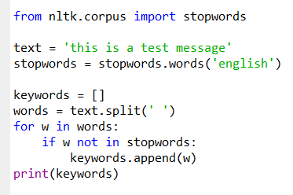
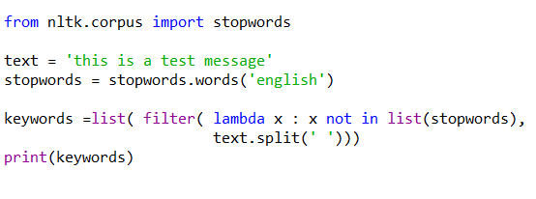

filter conditions on list
Filter function in Python takes in a function and a list as arguments.
SYNTAX: filter ( function, iterable )
Examples 1
Examples 2
Examples 3: without filter
Examples 3: with filter
Functions

Slide 24
Text preprocessing
Text Preprocessing steps
Part of speech tagging
Word tokenization
Sentence tokenization
Word stemming
Remove numbers and tags
Remove stop words
corpus
document
sentence
word
Character
NLTK package
Word cloud
matplotlib
Corpus : Body of text, singular. Corpora is the plural of this.
Lexicon : Words and their meanings.
Token : Each “entity” that is a part of whatever was split up based on rules.
Building Blocks of Text messages
slice indexing in python

Slide 25
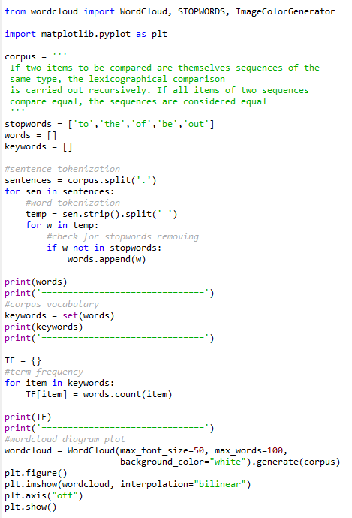
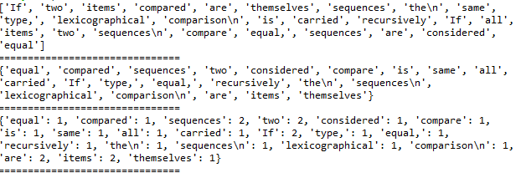
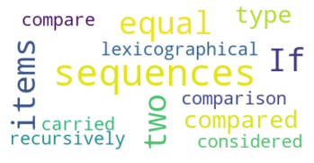
Text preprocessing
Example 1 : simple text pre processing
slice indexing in python

Slide 26
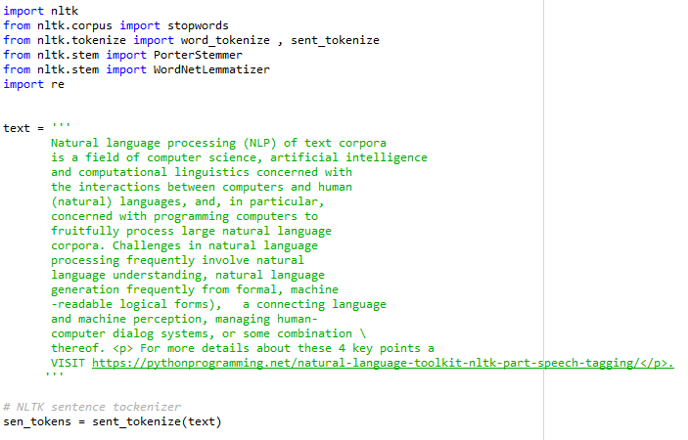
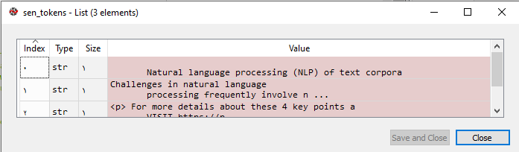
Text preprocessing with NLTK package
Step 1 : sentence tokenization
slice indexing in python

Slide 27
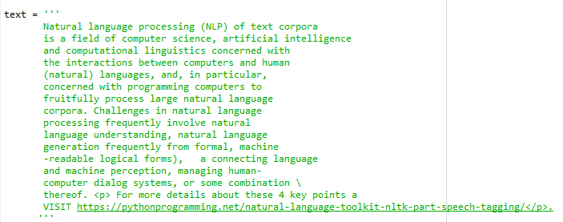
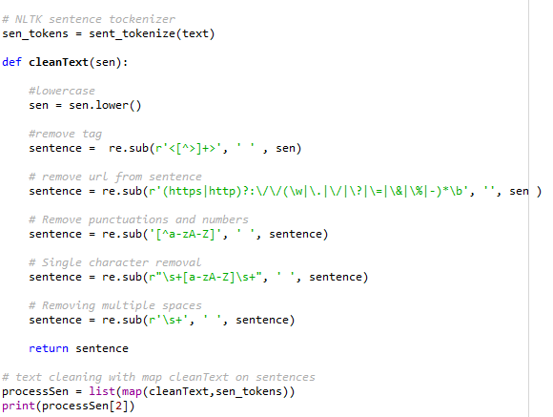
Step 2 : Remove tags, url, numbers and punctuations

Slide 28
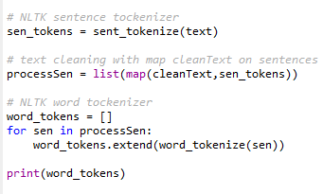
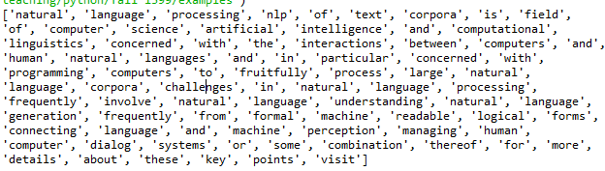
Step 3 : word tokenization

Slide 29
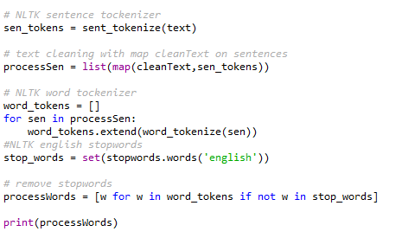
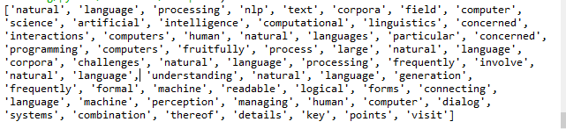
Step 4 : remove stopwords

Slide 30
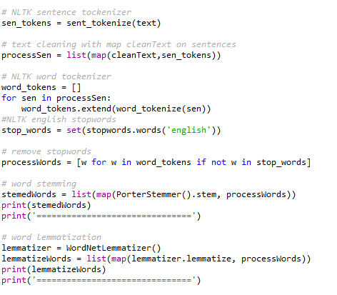
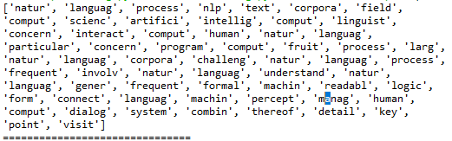
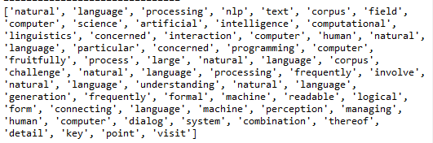
Step 4 : word stemming and word lemmatization
Stemmed words
lemmatized words

Slide 31
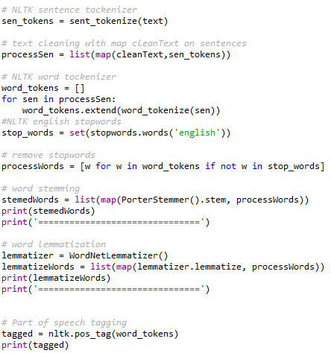
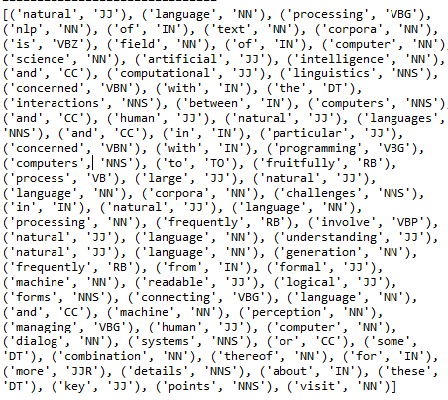
Step 5 : Part of Speech tagging
For more detail

Slide 32
Exercise
slice indexing in python

